Slide 1
Attributes of Graphics Primitives

Slide 2
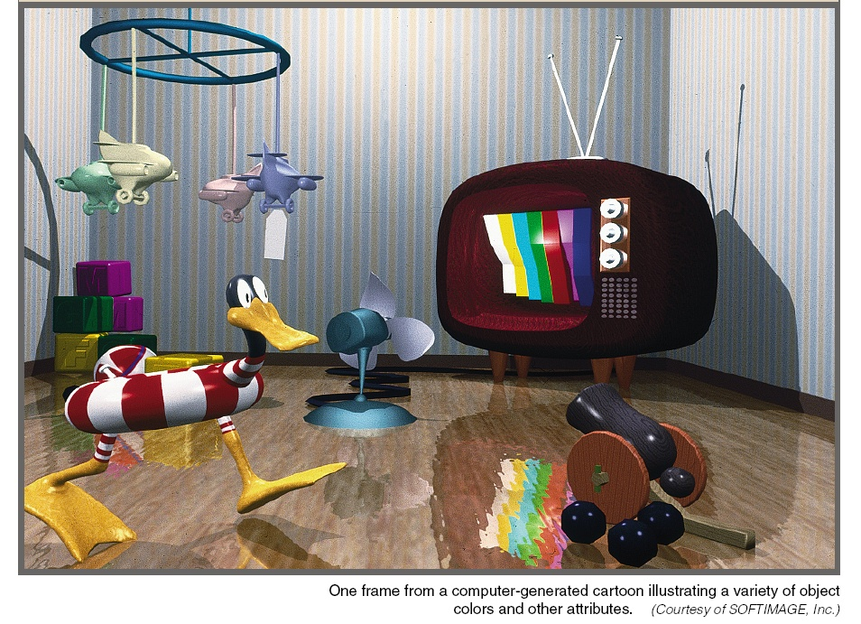

Slide 3
Attributes of Graphics Systems
Attribute parameter: a parameter that affects the way a primitive is to be displayed
Attributes may:
  Determine the fundamental characteristics of a primitive such as color and size.
  Specify how the primitive is to be displayed under special; conditions such as visibility.

Slide 4
Color and Grayscale: RGB color components
RGB color can be stored in two ways:
- Direct storgse scheme (Frame Buffer)
- indexed storage scheme (color tables)

Slide 5
Color and Grayscale: Direct storgse scheme
  Color code placed at pixel location
  Minimum number of colors for 3-bits
  Left bit → Red, Middle bit → Green, Right bit → Blue
  0 → black, 1 → blue, …, 7 → white
  More color bits increase the size of the frame buffer: 24-bits * 1024 * 1024 = 3MB

Slide 6
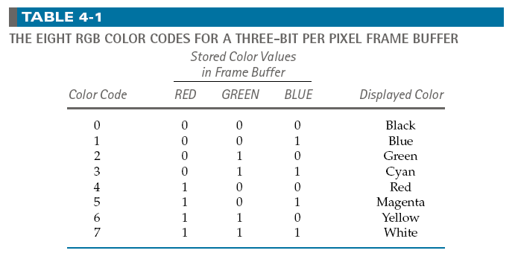
Color and Grayscale: Direct storgse scheme
Minimum of 3 bits of storage per pixel, one bit for each color componenet
Requires large storage amount for frame buffer.

Slide 7
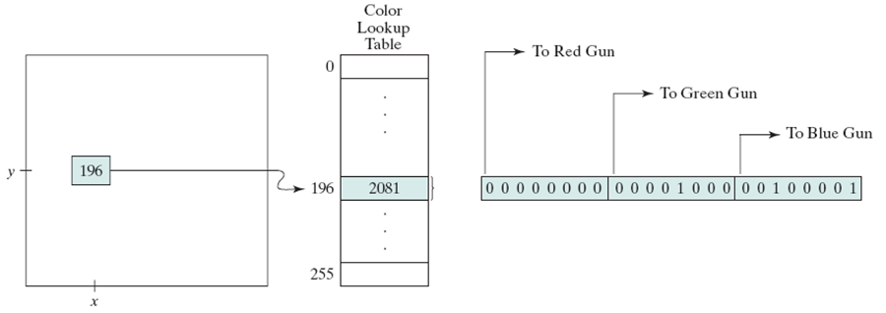
Color and Grayscale: Indexed storage scheme
color lookup tables- colormap: Reduces frame buffer storage

Slide 8
Color and Grayscale: Gray scale
RGB color functions are used to set shades of gray, or gray scale.
When an RGB color setting specifies an equal amount of red, green, and blue, the result is some shade of gray
Values close to 0 for the color components produce dark gray, and higher values near 1.0 produce light gray

Slide 9
Color and Grayscale: Other Color Parameters
Other three-component color representations are useful in computer-graphics applications
For example, color output on printers is described with cyan, magenta, and yellow color components (CMY color model)
Color interfaces sometimes use parameters such as lightness and darkness to choose a color

Slide 10
Color and Grayscale: Color Blending
In many applications, it is convenient to be able to combine the colors of overlapping objects or to blend an object with the background
Most graphics packages provide methods for producing various color-mixing effects, and these procedures are called color-blending functions or image-compositing functions.

Slide 11
Color and Grayscale: Color Blending
The RGBA mode is used
glutInitDisplayMode(GLUT_SINGLE | GLUT_RGBA);
A = alpha coefficient, used to control color blending for overlapping primitives
    void init ( void)
    {----
    glEnable (GL_BLEND);
    ---
    glDisable (GL_BLEND);
    }

Slide 12
Color and Grayscale: Color Blending
glClear (GL_COLOR_BUFFER_BIT); //apply clear color to color buffer
glBegin(GL_QUADS); // Drawing Using Quads
glColor4f(0.0, 1.0, 0.0,0.5); // set color to Green
glVertex2i( 80, 10); // First Quad
glVertex2i(120,10);
glVertex2i(120,100);
glVertex2i(80,100);
glColor4f(0.0, 0.0, 1.0,0.5); // set color to blue
glVertex2i( 10, 10); // Second Quad
glVertex2i(110,10);
glVertex2i(110,50);
glVertex2i(10,50);
glEnd(); // finished drawing the Quads

Slide 13
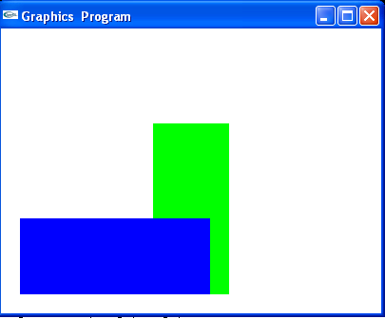
Color and Grayscale: Color Blending
Without enabling the blending parameter:

Slide 14
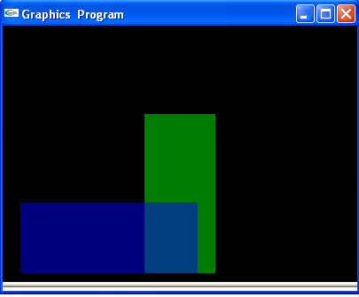
Color and Grayscale: Color Blending
After enabling the blending parameter and setting its value to 0.5:

Slide 15
Point Atributes and Functions
Two attributes: color and size
Color components are set with RGB values or an index into a color table
glColor3f(0.0, 1.0, 0.0); // set color to Green
glVertex2i( 80, 10);
point size is an integer multiple of the pixel size
    glPointSize (size); // size is the number of pixels
    glVertex2i(80,10);

Slide 16
Line Attributes and Functions
Line attributes
  Basic attributes: color, width, style
  Width
    can be set in the line drawing algorithm.
    Raster algorithms display line attributes by plotting pixel spans, like plotting multiple pixels along the line either horizontally (m<1)or vertically (m>1).
    Lines are Produced with abrupt ends (horizontal or vertical).
    Add line caps at the end (butt cap, round cap, projecting square cap).

Slide 17


Line Attributes and Functions
Line attributes
    Width
    Bresenham + additional vertical (horizontal) spans.
    Width dependent on line slope
    Line caps
Butt round caps square

Slide 18

Line Attributes and Functions
Line attributes
  thick polylines with previous method do not connect smoothly
    miter join: extend the outer boundaries of each segment until they join
    round join: cap connection with circular boundary
    bevel join: display line segments with butt caps and fill-in triangular gap between the two butts.

Slide 19

Line Attributes and Functions
Line attributes
  Style
    Solid lines, dashed lines, dotted lines can be generated by modifying the line drawing algorithm – spacing between drawn pixels
    Can be also generated from the raster by using a pixel mask, for example 11111000 will display a dashed line with dash length of 5 and inter-dash length of 3.

Slide 20
Line Attributes and Functions
Line Width:
    glLineWidth (width); // width is the width of the
    line default width is 1.0
Line Style:
glLineStipple (repeatFactor, pattern);
  Requires first: glEnable (GL_LINE_STIPPLE);
  line-pattern feature can be disabled by glDisable (GL_LINE_STIPPLE);

Slide 21
Line Attributes and Functions
  Line style:
  glLineStipple (repeatFactor, pattern);
  glLineStipple (1, 0x00FF);
  pattern references a 16-bit integer that describes how the line should be displayed (default 0xFFFF, all bits set to 1, solid line)
  repeatFactor specifies how many times each bit in the pattern is to be repeated before the next bit in the pattern in applied (default 1).
  Example: displays 0x00FF -------- -------- -------- …
  8 solid line pixels, followed by 8 spaces

Slide 22
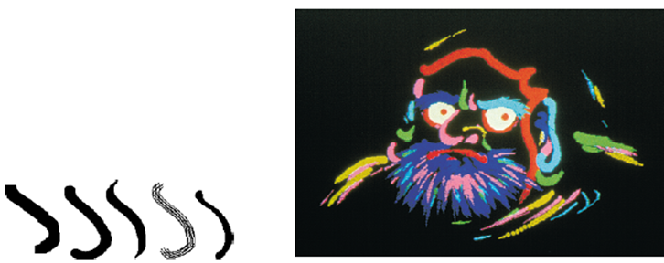
Curve Attributes
Attributes are the same as for line segments.

Slide 23
Character Attributes
Character attributes
  Font (typeface) represent styles
  Helvetica, Courier, Times Roman, …
  Underlining style
  solid, dotted, double
  Style
  boldface, italics, outline, shadow
  Size
  10-point, 12-point, …
  Color.

Slide 24
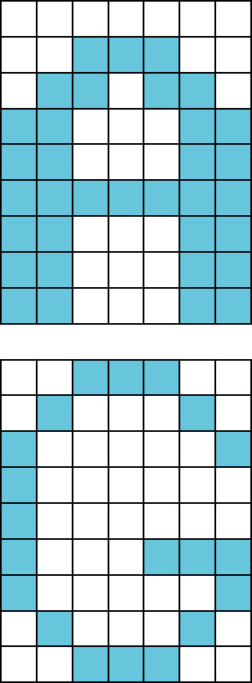
Character Attributes
Bitmap / Raster character:
    Can be scaled, but not rotated
    Simple to define
    Fast to process
Bitmap / Raster character:

Slide 25
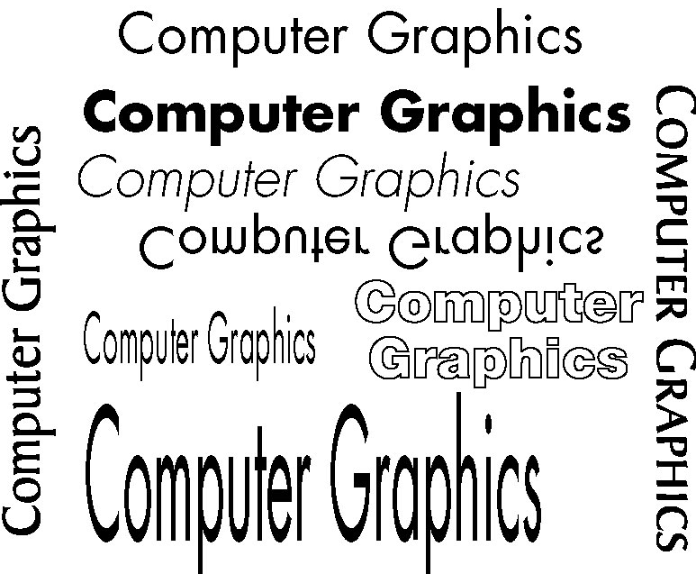
Character Attributes
Stroke character:
  Can be handled like any other object – geometric transformations
  Can be defined once then translated, rotated, and scaled as many times as needed (display lists)
  Complex to define
  Take much memory and processing time

Slide 26
Character Attributes
You have to use glRasterPos to set the raster position before calling glutBitmapString()
Note that each call to glutBitmapString() advances the raster position, so several consecutive calls will print out the strings one after another.
You can also set the text color by using glColor().
  glRasterPos2i(100, 120);
  glColor4f(0.0f, 0.0f, 1.0f, 1.0f);
  glutBitmapString(GLUT_BITMAP_HELVETICA_18, "text to render");

Slide 27
Character Attributes
Void Testingtext (void){
//Glut font
int font1 = GLUT.BITMAP_HELVETICA_12;
int font2 = GLUT.BITMAP_TIMES_ROMAN_24;
//Set color
glColor3f (1.0f, 0.0f, 0.0f);
//Go to the bottom left position of the text
glRasterPos2i(100, 100);
//Draw the text
glutBitmapString(font1, "Text drawn with GLUT helvetica 12");

Slide 28
Character Attributes
  //Set color
glColor3f (0.0f, 1.0f, 0.0f);
//Go to the bottom left position of the text
glRasterPos2i(5, 200);
//Draw the text
glutBitmapString(font2, "Text drawn with GLUT times roman 24");
}

Slide 29
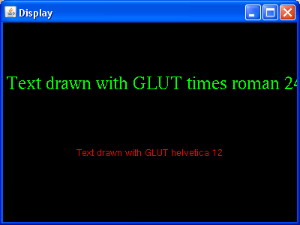
Character Attributes

Slide 30
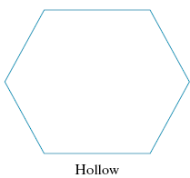
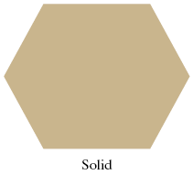
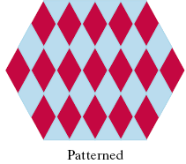
Fill Area Attributes
Display style of interior:
- single color (solid)
- showing only boundary (hollow)
- specified fill pattern (patterned)
Show edges of polygons in diffrent color, widthes and style.

Slide 31
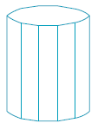

File Area Primitives
Another useful component beside geometric objects is describing an area with filled color
Referred to as fill area or filled area
Most graphics routins require the fill area to specified as polygon
- their boundries are described by linear equations.
- most surface can be approximated by polygons (called surface tessellation)

Slide 32
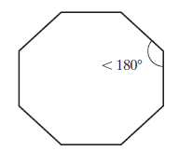
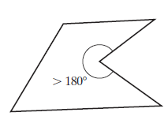
Polygon Fill Area
Polygons: plane figure specified by three or more vertices and connected by edges
Has all vertices within plane- no edge crossing
Polygon classification:
- Convex: interior angle = or less than 180 degrees
- Concave: interior angle greater than 180 degrees
Implementations for filling algorithms are complicated for concave polygons
convex
concave

Slide 33
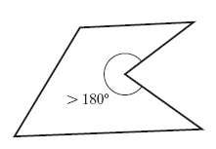
Polygon Fill Area
Identifying concave polygons
- extension of some edges will intersect other edges
- take a look at the polygon vertex positions relative to the extension line of any edge: some vertices are on one side and some are on the other

Slide 34
Representing Polygons
Vertex and edge tables:
  Each vertex listed once
  Each edge is an ordered pair of indices to the vertex list
  Sufficient to draw shape and perform simple operations (transforms, point inside/outside)
  Edges listed in counterclockwise winding order
Vertices
0 | (0, 0)
1 | (2, 0)
2 | (0, 1)
3 | (2, 1)
4 | (1, 1.5)
Edges
0 | (0, 1)
1 | (1, 3)
2 | (3, 4)
3 | (4, 2)
4 | (2, 0)
E₃
V₄
E₂
V₂
V₃
E₄
E₁
E₀
V₀
V₁

Slide 35
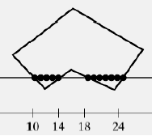
Scan-Line Polygon-Fill Algorithm
interior pixels along a scan line passing through a polygon area

Slide 36
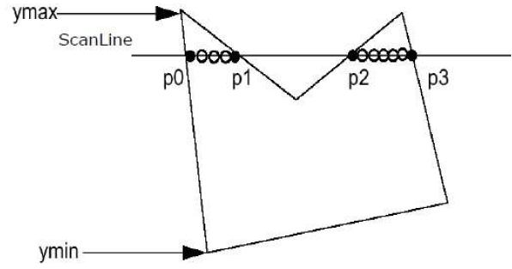
Scan-Line Polygon-Fill Algorithm
This algorithm works by intersecting scanline with polygon edges and fills the polygon between pairs of intersections.
The following steps depict how this algorithm works.
Step 1 − Find out the Ymin and Ymax from the given polygon.
Step 2 − ScanLine intersects with each edge of the polygon from Ymin to Ymax. Name each intersection point of the polygon. As per the figure shown above, they are named as p0, p1, p2, p3.

Slide 37
Scan-Line Polygon-Fill Algorithm
Step 3 − Sort the intersection point in the increasing order of X coordinate i.e. p0, p1, p1, p2, and
p2, p3.
Step 4 − Fill all those pair of coordinates that are inside polygons and ignore the alternate pairs.

Slide 38
Scan-Line Polygon-Fill Algorithm
Scan-line polygon-fill algorithm
  For convex polygons.
    Determine the intersection positions of the boundaries of the fill region with the screen scan lines.
A
B
y
F
C
E
D

Slide 39
Scan-Line Polygon-Fill Algorithm
Scan-line polygon-fill algorithm
  For concave polygons.
    Scan line may intersect more than once:
      Intersects an even number of edges
      Even number of intersection vertices yields to pairs of intersections, which can be filled as previously
A
A
C
C
B
B
D
D
y
y
G
G
F
E
F
E

Slide 40
Scan-Line Polygon-Fill Algorithm
Scan-line polygon-fill algorithm
  For concave polygons.
    Scan line may intersect more than once:
      Intersects an odd number of edges
      Not all pairs are interior: (3,4) is not interior.
A
B
C
y
1
2
3
4
5
G
D
F
E

Slide 41
Scan-Line Polygon-Fill Algorithm
scan line
y+1
y
y-1
y increasing:
decrease by 1
y decreasing:
decrease by 1
The y-coordinate of the upper
endpoint of the current edge
is decreased by 1.
The y-coordinate of the upper
endpoint of the next edge
is decreased by 1.

Slide 42
Scan-Line Polygon-Fill Algorithm
Polygon fill-in algorithm
store the edges in a sorted edge table
where each entry corresponds to a scan line
(sorted on the smallest y value on each edge)
shorten the edges that have vertex-intersection
issues
process scan lines from bottom of polygon to top
(active edge list)
for each scan line, fill-in the pixel spans for each
pair of x intercepts.

Slide 43
Flood Fill Algorithm
Sometimes we come across an object where we want to fill the area and its boundary with different colors.
We can paint such objects with a specified interior color instead of searching for particular boundary color as in boundary filling algorithm.
Instead of relying on the boundary of the object, it relies on the fill color.
In other words, it replaces the interior color of the object with the fill color.
When no more pixels of the original interior color exist, the algorithm is completed.

Slide 44
Boundary Fill Algorithm
The boundary fill algorithm works as its name.
This algorithm picks a point inside an object and starts to fill until it hits the boundary of the object.
The color of the boundary and the color that we fill should be different for this algorithm to work.

Slide 45
Fill-Area Attributes
OpenGL fill-area routines for convex polygons only.
Four steps:
  Define a fill pattern
  Invoke the polygon-fill routine
  Activate the polygon-fill feature
  Describe the polygons to be filled.

Slide 46
Fill-Area Attributes
Define a fill pattern
  Store pattern in a 32 x 32 byte array (fillPattern)
  Bytes are numbered from right to left
Invoke the polygon-fill routine
glPolygonStipple ( fillPattern)
Activate the polygon-fill feature
glEnable ( GL_POLYGON_STIPPLE )
Describe the polygons to be filled
glBegin ( GL_POLYGON )
At the end
glDisable ( GL_POLYGON_STIPPLE )

Slide 47
Fill-Area Attributes
  glPolygonStipple (fly);
  glEnable (GL_POLYGON_STIPPLE);
  glBegin (GL_POLYGON);
  glColor3f (1.0f, 0.0f, 0.0f);
  glVertex2i (50,50);
glColor3f (1.0f, 0.0f, 1.0f);
glVertex2i (150,50);
glColor3f (0.0f, 1.0f, 0.0f);
glVertex2i (75,150);
  glEnd ( );
  glDisable (GL_POLYGON_STIPPLE);

Slide 48
Fly pattern
GLubyte fly[] = { 0x00, 0x00, 0x00, 0x00, 0x00, 0x00, 0x00, 0x00, 0x03, 0x80, 0x01, 0xC0, 0x06, 0xC0, 0x03, 0x60, 0x04, 0x60, 0x06, 0x20, 0x04, 0x30, 0x0C, 0x20, 0x04, 0x18, 0x18, 0x20, 0x04, 0x0C, 0x30, 0x20, 0x04, 0x06, 0x60, 0x20, 0x44, 0x03, 0xC0, 0x22, 0x44, 0x01, 0x80, 0x22, 0x44, 0x01, 0x80, 0x22, 0x44, 0x01, 0x80, 0x22, 0x44, 0x01, 0x80, 0x22, 0x44, 0x01, 0x80, 0x22, 0x44, 0x01, 0x80, 0x22, 0x66, 0x01, 0x80, 0x66, 0x33, 0x01, 0x80, 0xCC, 0x19, 0x81, 0x81, 0x98, 0x0C, 0xC1, 0x83, 0x30, 0x07, 0xe1, 0x87, 0xe0, 0x03, 0x3f, 0xfc, 0xc0, 0x03, 0x31, 0x8c, 0xc0, 0x03, 0x33, 0xcc, 0xc0, 0x06, 0x64, 0x26, 0x60, 0x0c, 0xcc, 0x33, 0x30, 0x18, 0xcc, 0x33, 0x18, 0x10, 0xc4, 0x23, 0x08, 0x10, 0x63, 0xC6, 0x08, 0x10, 0x30, 0x0c, 0x08, 0x10, 0x18, 0x18, 0x08, 0x10, 0x00, 0x00, 0x08};

Slide 49
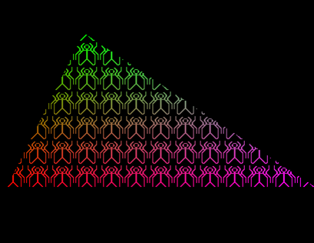
Fly pattern

Slide 50
Halftone pattern
GLubyte halftone[] = { 0xAA, 0xAA, 0xAA, 0xAA, 0x55, 0x55, 0x55, 0x55, 0xAA, 0xAA, 0xAA, 0xAA, 0x55, 0x55, 0x55, 0x55, 0xAA, 0xAA, 0xAA, 0xAA, 0x55, 0x55, 0x55, 0x55, 0xAA, 0xAA, 0xAA, 0xAA, 0x55, 0x55, 0x55, 0x55, 0xAA, 0xAA, 0xAA, 0xAA, 0x55, 0x55, 0x55, 0x55, 0xAA, 0xAA, 0xAA, 0xAA, 0x55, 0x55, 0x55, 0x55, 0xAA, 0xAA, 0xAA, 0xAA, 0x55, 0x55, 0x55, 0x55, 0xAA, 0xAA, 0xAA, 0xAA, 0x55, 0x55, 0x55, 0x55, 0xAA, 0xAA, 0xAA, 0xAA, 0x55, 0x55, 0x55, 0x55, 0xAA, 0xAA, 0xAA, 0xAA, 0x55, 0x55, 0x55, 0x55, 0xAA, 0xAA, 0xAA, 0xAA, 0x55, 0x55, 0x55, 0x55, 0xAA, 0xAA, 0xAA, 0xAA, 0x55, 0x55, 0x55, 0x55, 0xAA, 0xAA, 0xAA, 0xAA, 0x55, 0x55, 0x55, 0x55, 0xAA, 0xAA, 0xAA, 0xAA, 0x55, 0x55, 0x55, 0x55, 0xAA, 0xAA, 0xAA, 0xAA, 0x55, 0x55, 0x55, 0x55, 0xAA, 0xAA, 0xAA, 0xAA, 0x55, 0x55, 0x55, 0x55};

Slide 51
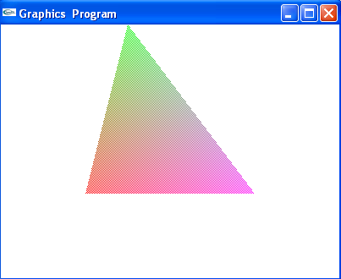
Halftone pattern

